Slide 1
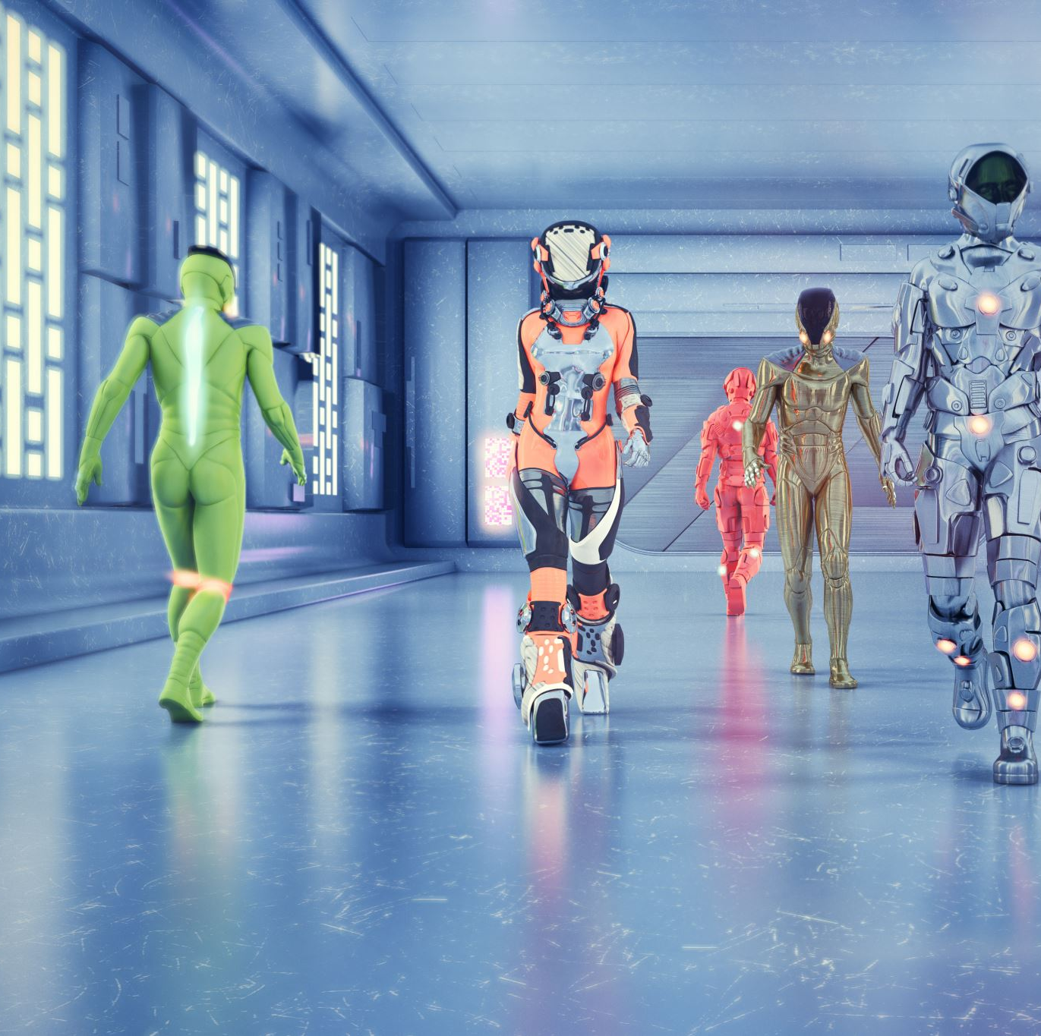
Transformers
NLP & LLM
Part 2

Slide 2

Agenda
USE CASES LLM
TRANSFORMERS KICK OFF
TEXT PROCESSING IN LLM
DECODER - ENCODER
SELF ATTENTION
Hugging Face
MODEL TUNNING

Slide 3

Use Cases LLM
Text generation
Conversational AI
Extraction / Parsing
Text Summarization
Text classification
Topic Categorization
Sentiment Analysis
Spam Detection
Toxicity Detection
Intent Recognition
Product Categorization
This Photo by Unknown author is licensed under CC BY-SA.

Slide 4
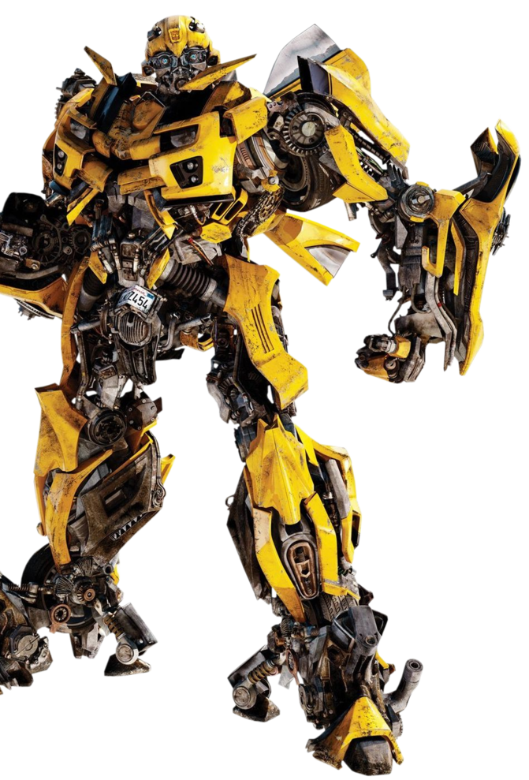
TRANSFORMERS
This Photo by Unknown author is licensed under CC BY-NC.

Slide 5
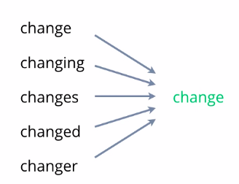
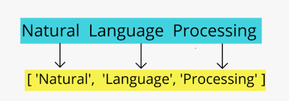
Transformers.Text_processing()
Tokenization
Lemmatization

Slide 6
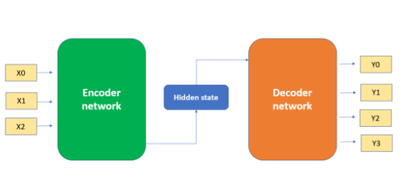
Transformers.Decoder_Encoder()

Slide 7
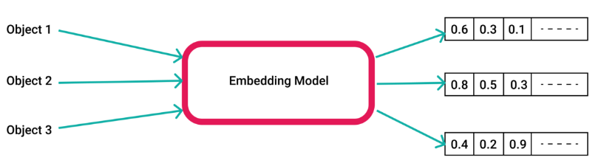
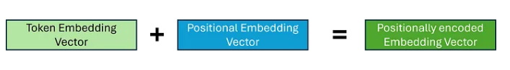
Transformers.Decoder_Encoder()

Slide 8
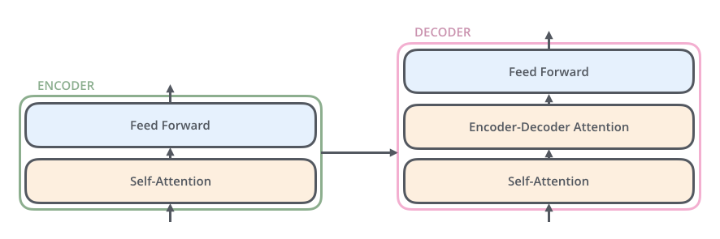
Transformers.Self_attention()

Slide 9

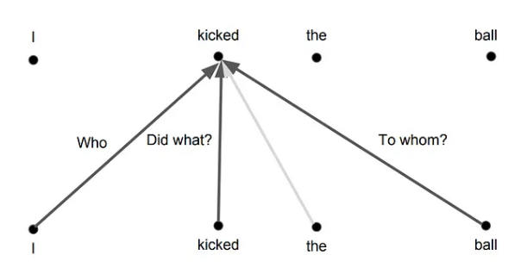
Transformers Self attention

Slide 10
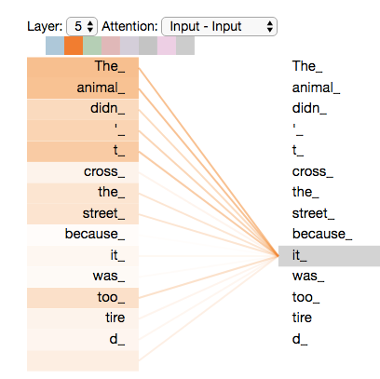
Transformers Self attention

Slide 11
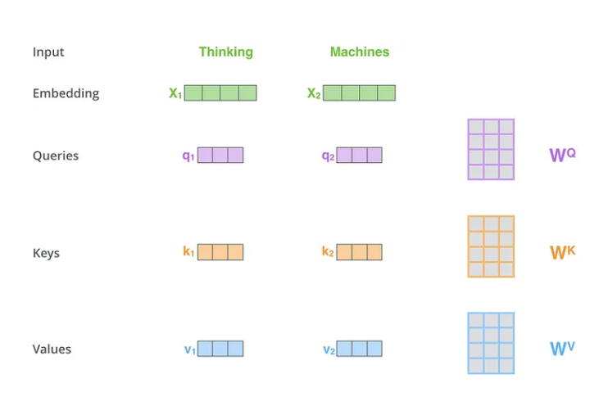

Slide 12
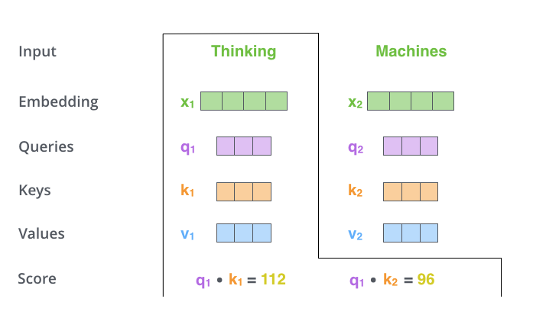

Slide 13
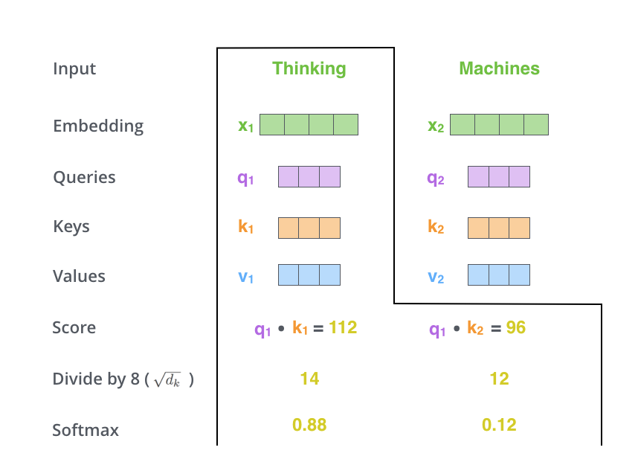

Slide 14
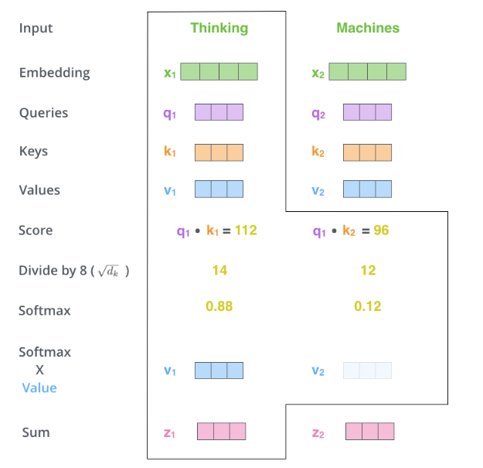
https://jalammar.github.io/illustrated-transformer/

Slide 15





DS.Hints
Best model sources
Hugging Face
Papers with Code
Best research sources
Towards Data Science
Medium
Kaggle

Slide 16

Hugging Face (HF)
This Photo by Unknown author is licensed under CC BY-NC-ND.

Slide 17

Use Case –Text Classification

Slide 18
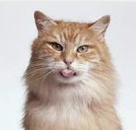
Homework
Complete task: 1) Find texts about cats, add 100+ random entries with text about cats and change its label to "Cat".You can add 'cats texts' to already used dataset in the notebook example 2) Train the model to classify and catch texts about cats
Simplified task:
1) Find and use any model for sentimental text classification (with labels Positive, Negative, Neutral) on the already used dataset in notebook example
2) Compare metrics for your model and the bert fine-tuned model (accuracy and f1-score)

